Slide 1
Important Concepts

Slide 2
Contents
One hot encoding
R square
Multi collinearity
Overfitting
Ridge and Lasso Regression
Logistic Regression
Accuracy, Recall, F-score

Slide 3
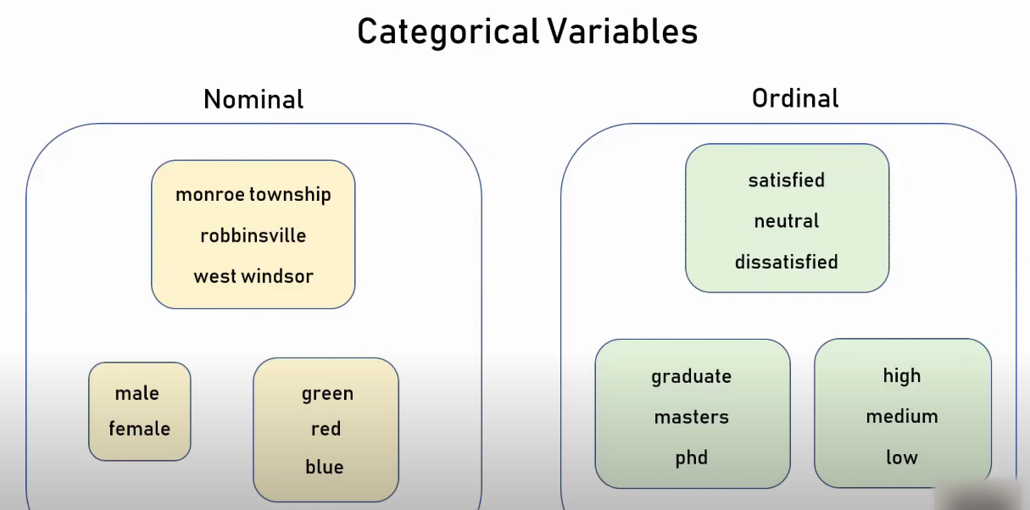

Slide 4
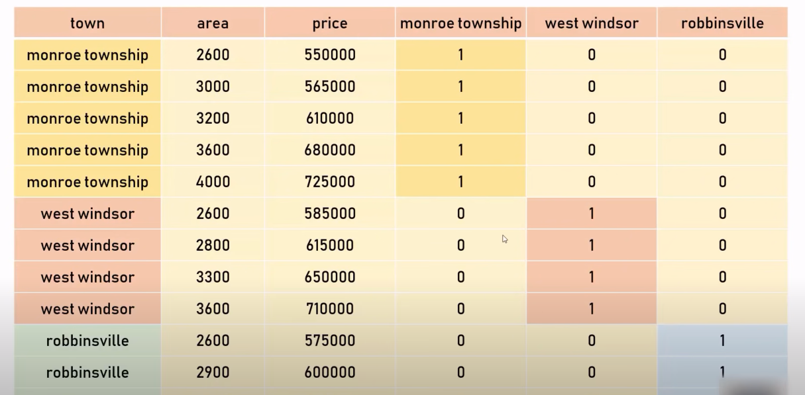
One hot encoding

Slide 5
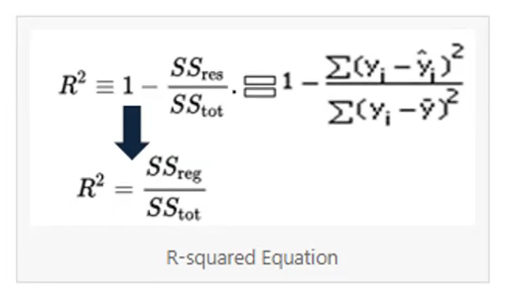
R Square
SS res = sum of residuals
SS tot = sum of means
y hat = y predicted value
y i = observations value
y bar= mean of observations

Slide 6
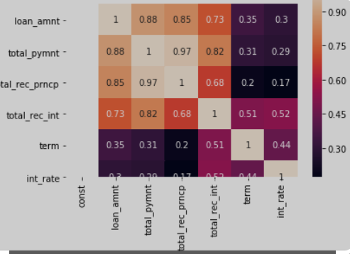
Multi collinearity

Slide 7
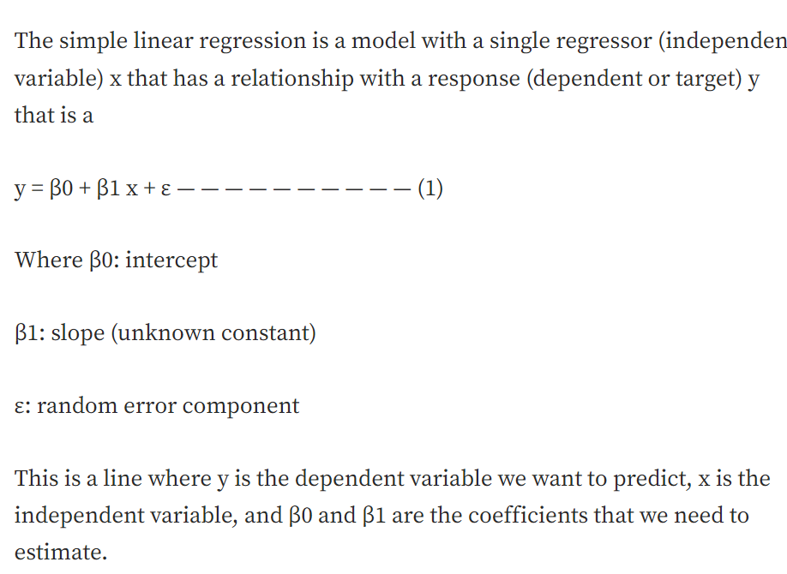
Ordinary Least Square
https://medium.com/analytics-vidhya/ordinary-least-square-ols-method-for-linear-regression-ef8ca10aadfc

Slide 8
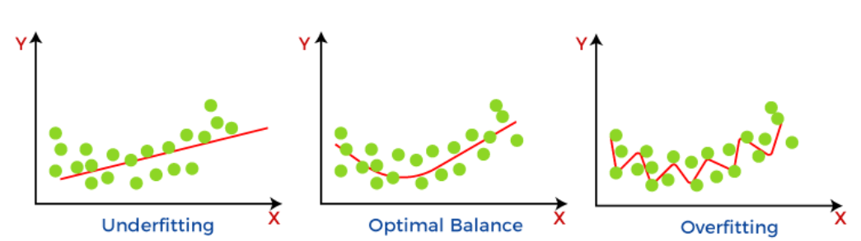
Bias and Variance

Slide 9
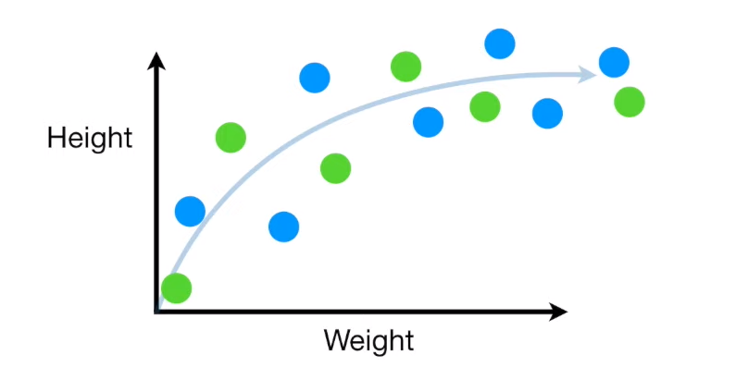
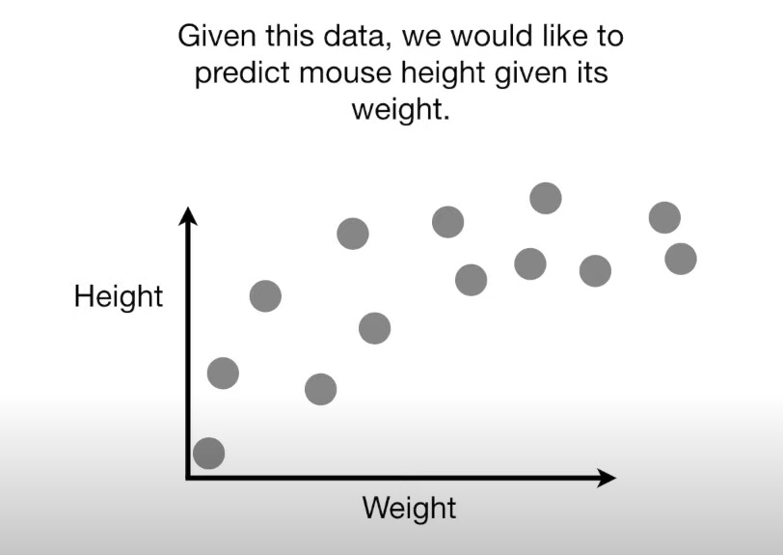
Bias and Variance

Slide 10
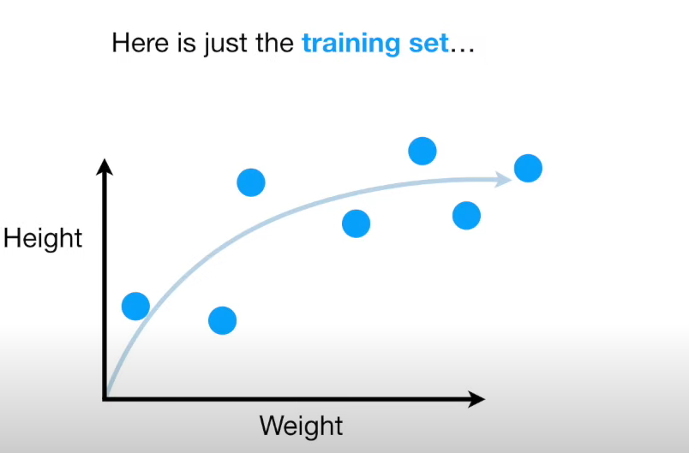

Slide 11
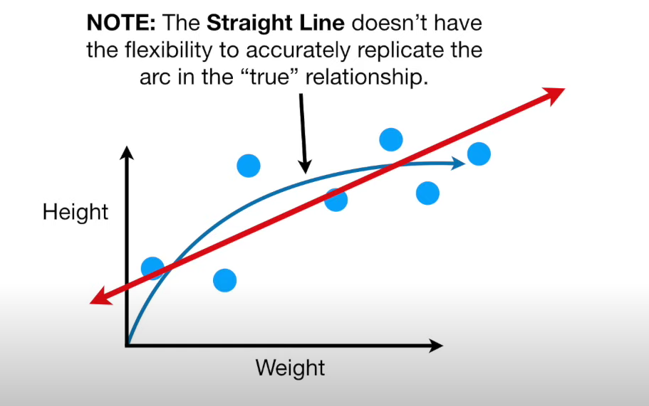

Slide 12
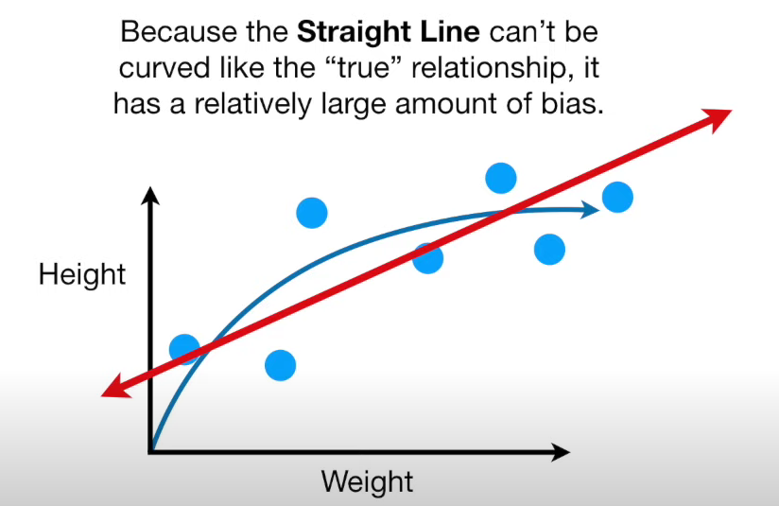
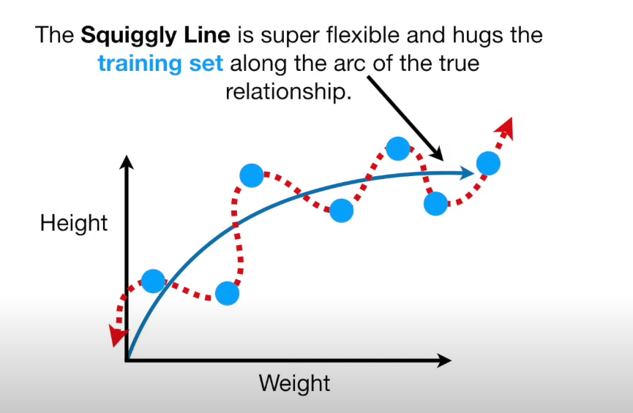

Slide 13
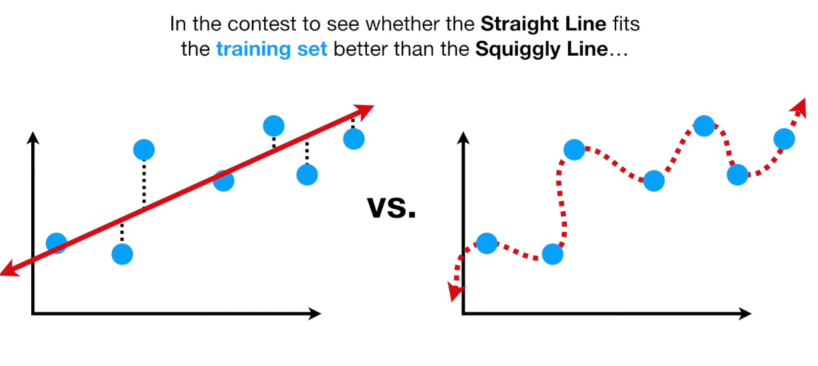
Training Set

Slide 14
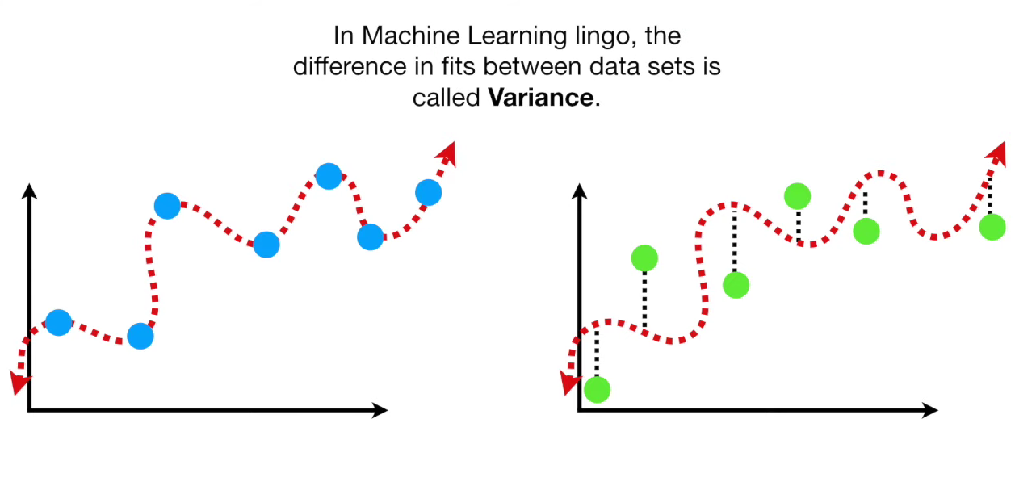

Slide 15
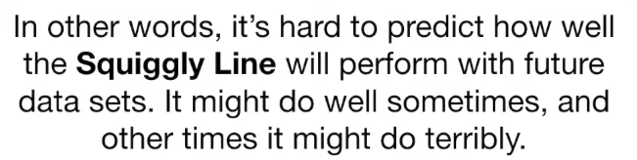
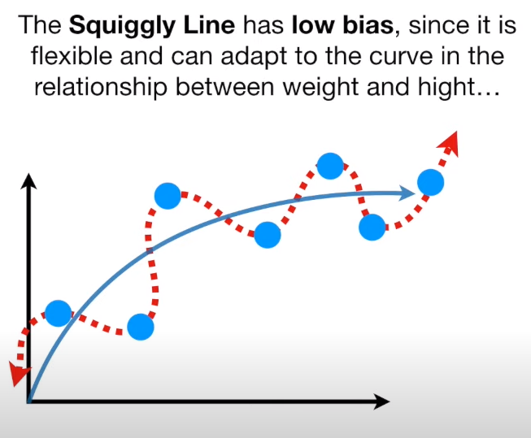
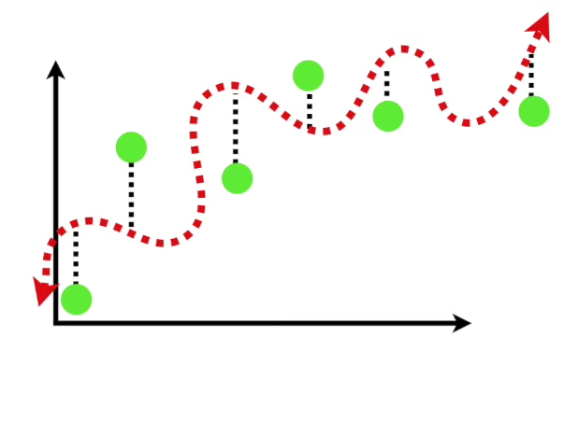

Slide 16
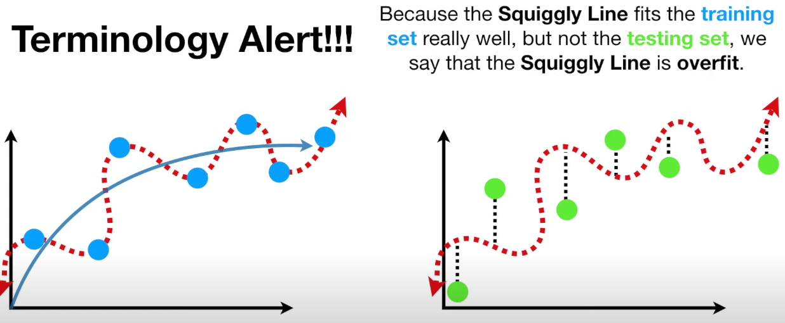

Slide 17
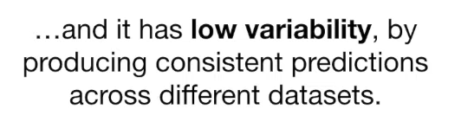
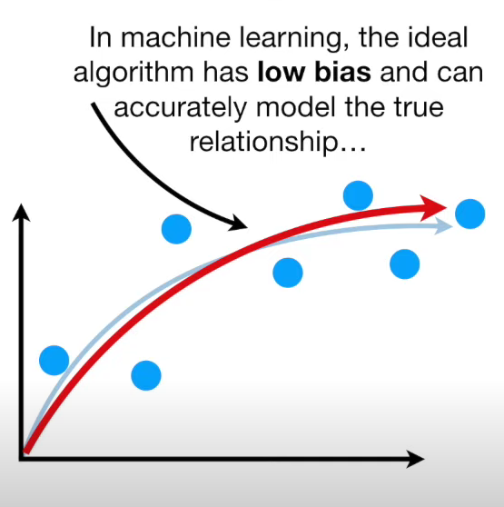
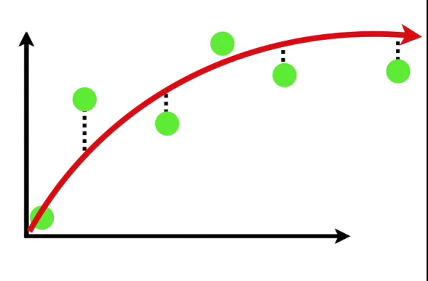
A good model

Slide 18
Finding the sweet spot
Regularization
Bagging
Boosting

Slide 19
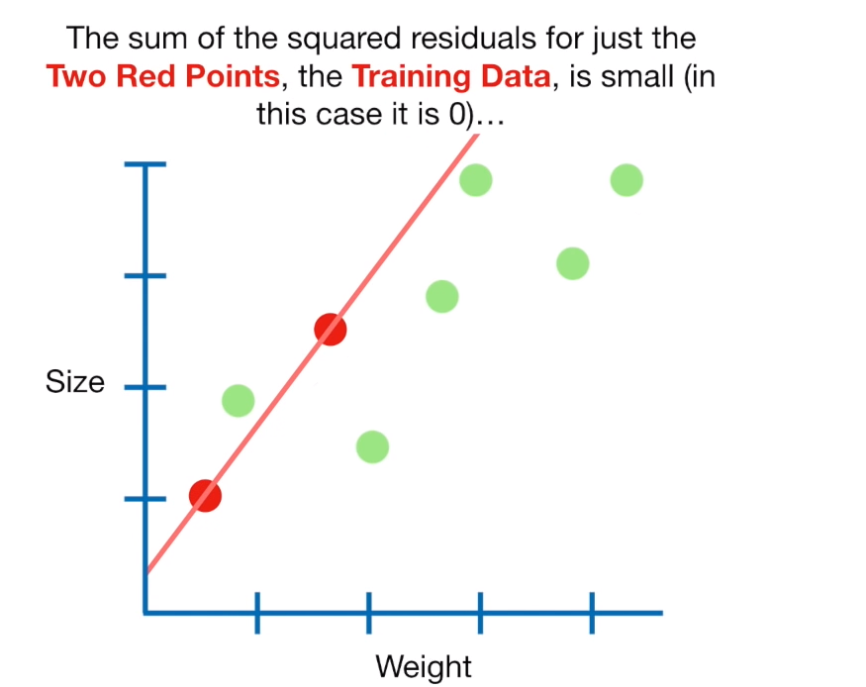
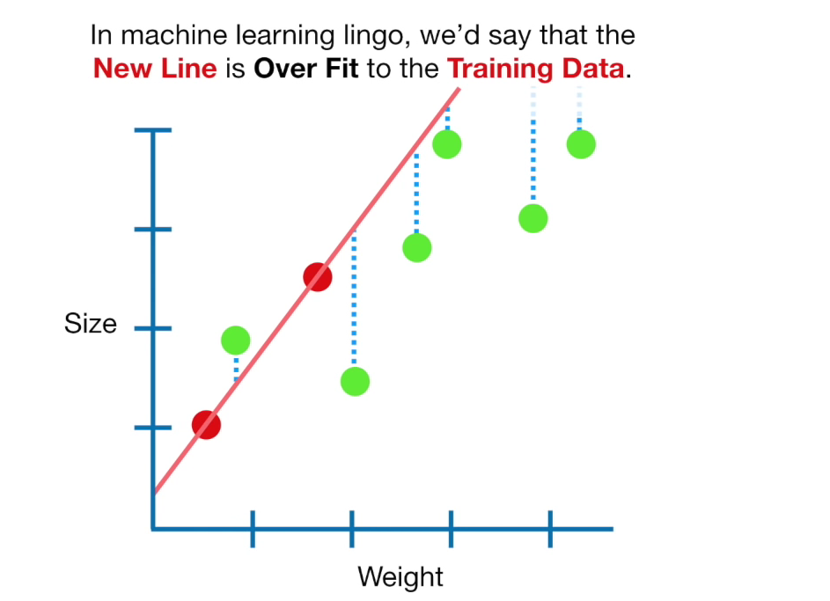
Ridge Regression

Slide 20
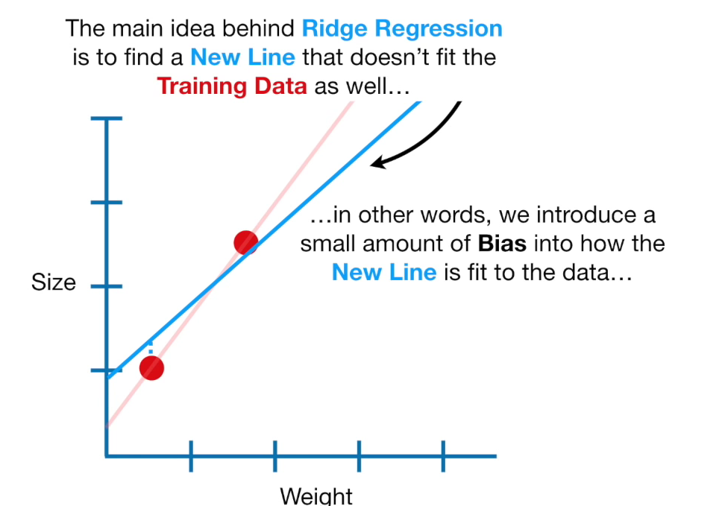
Ridge Regression

Slide 21
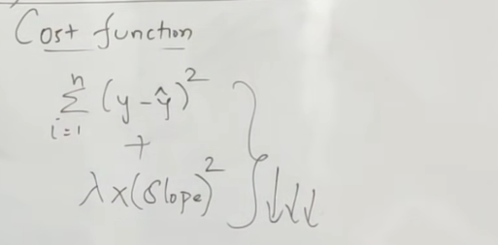
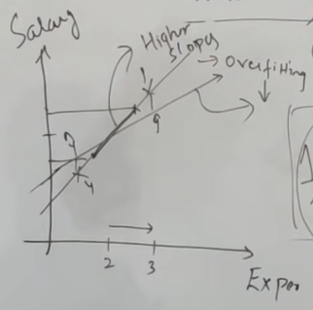
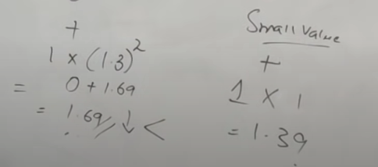
Ridge Regression: Intuition

Slide 22
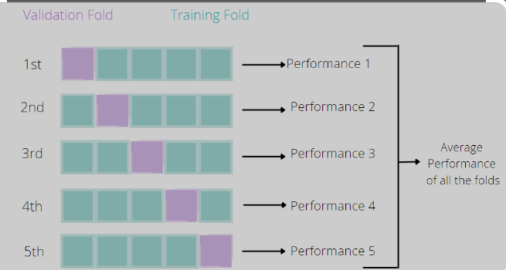
k fold Cross Validation

Slide 23
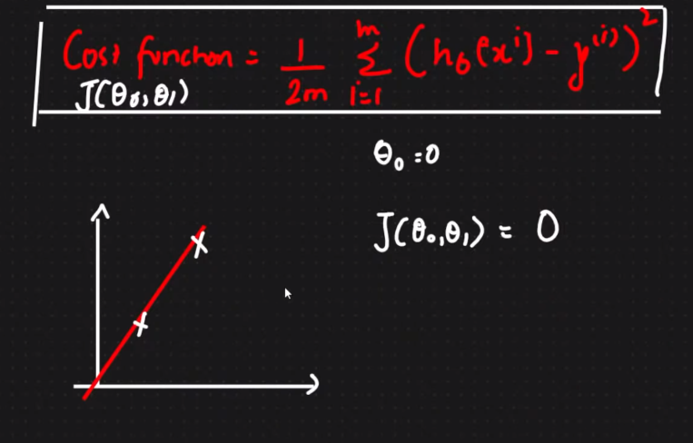
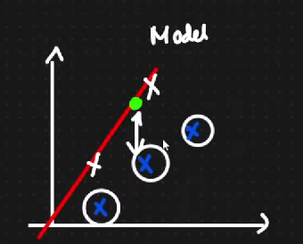
Overfitting

Slide 24
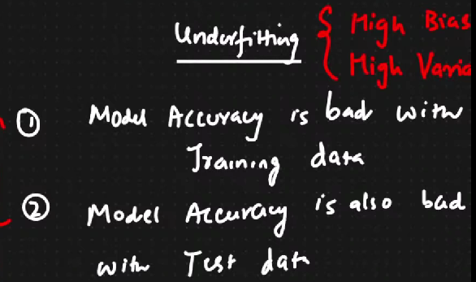
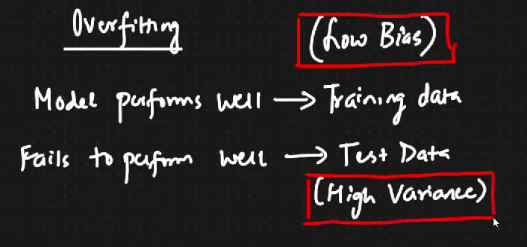
Bias and Variance
https://towardsdatascience.com/bias-variance-and-how-they-are-related-to-underfitting-overfitting-4809aed98b79#:~:text=It%20has%20a%20High%20Bias%20and%20a%20High%20Variance%2C%20therefore,therefore%20it's%20an%20ideal%20model.

Slide 25
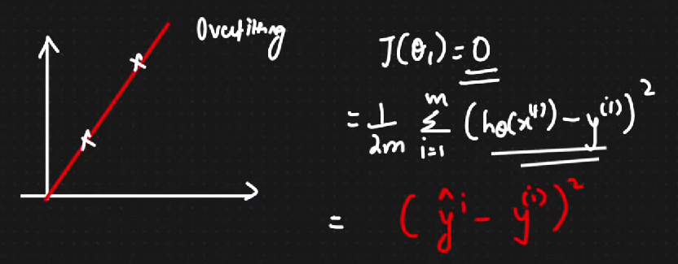
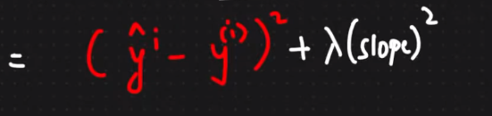
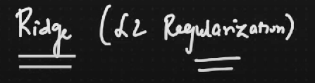
Ridge Regression (L2 Regularization)

Slide 26
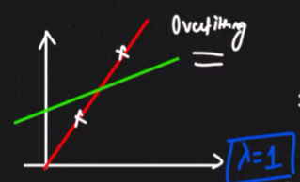
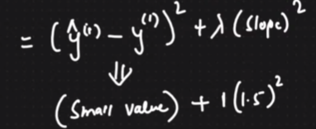
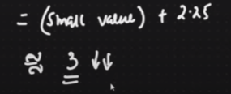
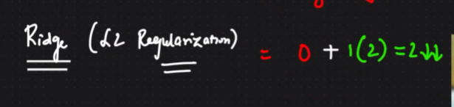
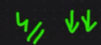
Ridge Regression (L2 Regularization)
https://www.youtube.com/watch?v=vaQxdBEcBzU&list=PLuBhMCi3ZJYk8R8OwfVSZYBJmL_qhVbkZ&index=2

Slide 27
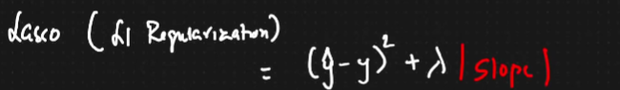
Lasso (L1 Regularization) : Feature Selection
Prevent overfitting
Neglecting redundant features
The idea is to reduce the cost function; advisable to perform both regularizations and check performance matrix.

Slide 28
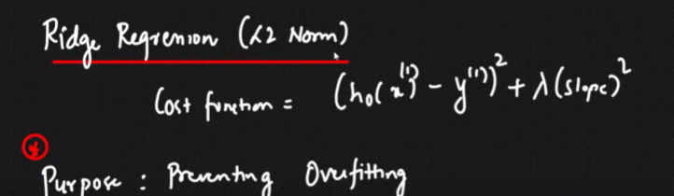
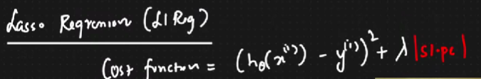

Ridge and Lasso Regression

Slide 29
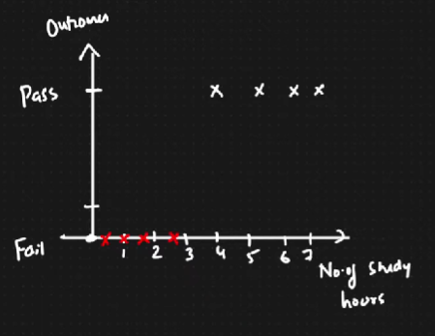
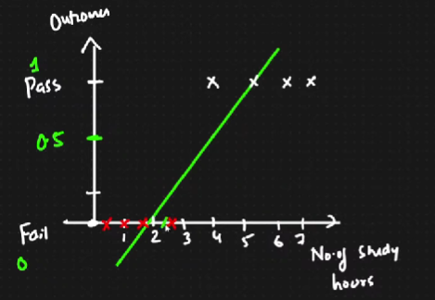
Logistic Regression

Slide 30
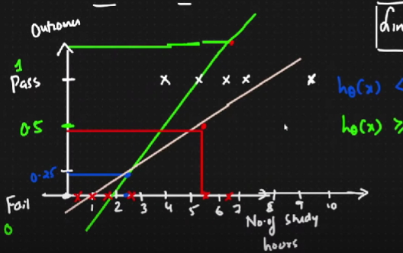
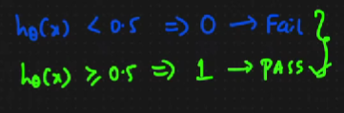
Logistic Regression

Slide 31
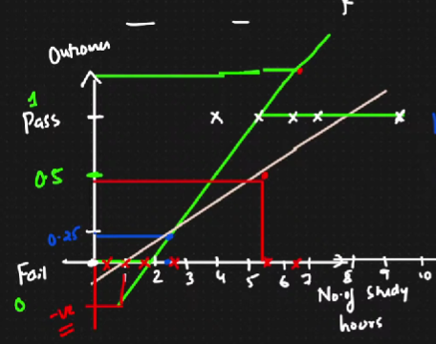
Logistic Regression: Squashing the function (activation function)

Slide 32
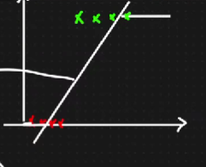
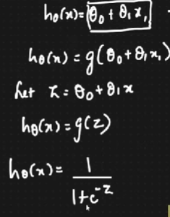

Logistic Regression: Squashing the function (activation function)

Slide 33


Logistic Regression

Slide 34

Cost Function

Slide 35



Performance Matrix : Confusion Matrix

Slide 36

Performance Matrix : Confusion Matrix

Slide 37


Accuracy metrics doesn’t work well for imbalance data!!
Precision, Recall, F-Score
Recall: Out of all the actual true values, how many are predicted as true values.
Reduce False negatives. (Sensitivity).
Precision: Out of all the predicted true values, how many are actually true. False Positive is given more priority.

Slide 38
Example problem statements:
Spam Classification : Precision??
Cancer: Recall (fatal/dangerous)?? False Negatives more priority
Stock Price Prediction: buyers and sellers

Slide 39


F-Beta Score

